Slide 1

A Review on Reinforced recommender systems
Kiarash Geraili
Computer Science Student at Mathematics and Computer Science Faculty
Amirkabir University of Technology
Email: kiarash.geraili@aut.ac.ir
Mohammad Akbari
Assistant Professor of Mathematics and Computer Science Faculty
Amirkabir University of Technology
Email: akbari.ma@aut.ac.ir
1/12

Slide 2
Sections
Introduction
Background
What is Reinforcement Learning (SAR, MDP, MAB)
What is a Recommender System (Ranking)
What is Reinforced Recommender system
Problem Formulation
Related works
2/12

Slide 3

Reinforcement Learning
Why RL instead of SL
State, Action, Reward
Reward Hypothesis
Transition Prob, Policy
Markovian Property
3/12

Slide 4

ALPHA-GO an Reinforced agent who beats Le sedol
4/12

Slide 5
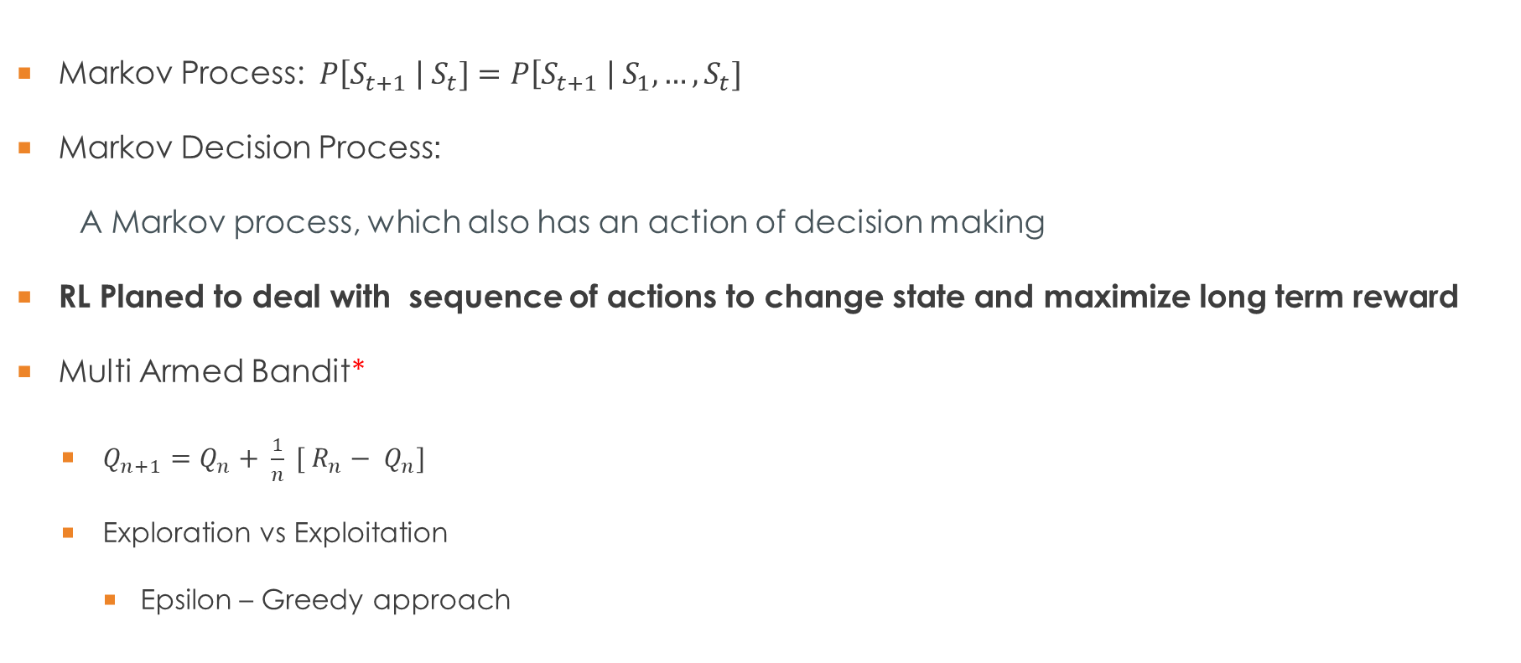
Background: Reinforcement Learning
Markov Process: $P\left[S_{t+1} \right| S_{t}]=P\left[S_{t+1} \right| S_{1},…,S_{t}]$
Markov Decision Process:
A Markov process, which also has an action of decision making
RL Planed to deal with sequence of actions to change state and maximize long term reward
Multi Armed Bandit*
$Q_{n+1}=Q_{n}+ \frac{1}{n} [ R_{n} {− Q}_{n}]$
Exploration vs Exploitation
Epsilon – Greedy approach
5/12

Slide 6
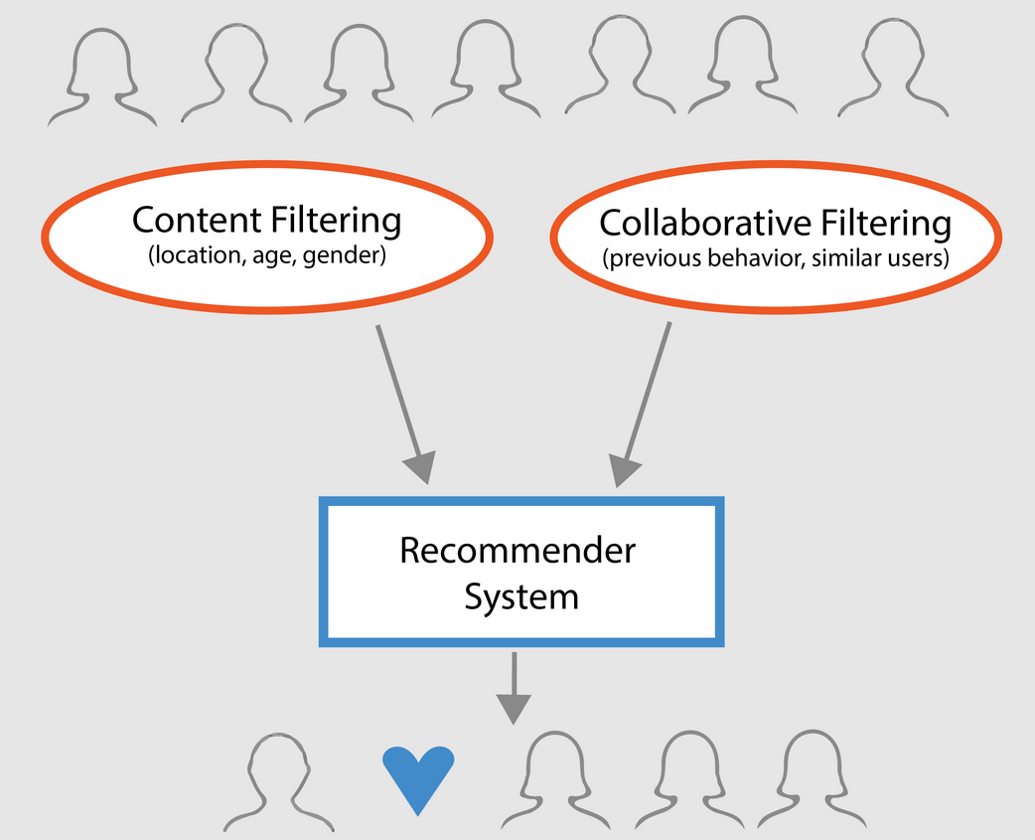
Background: Recommender systems
A recommender system, seeks to predict the "rating" or "preference" a user would give to an item
Traditional Models: Collaborative filtering, Content-Based filtering
Limitation:
Ignoring the dynamic interactive nature between users and agent
Focusing on the immediate feedback of recommended items
Only Observed feedback on items recommended by current system
6/12

Slide 7
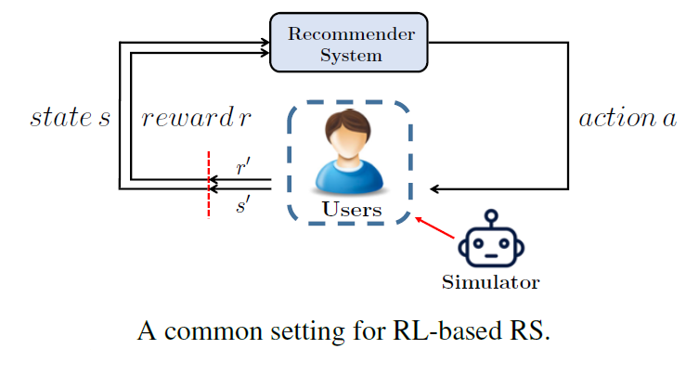
A common setting for Reinforced Recommender System
Benefit of our work?
How to Use RL for formulating Ranking problem?
Reward: purpose of recommendation, User preferences
Action: Recommendation
State: History of documents
7/12

Slide 8
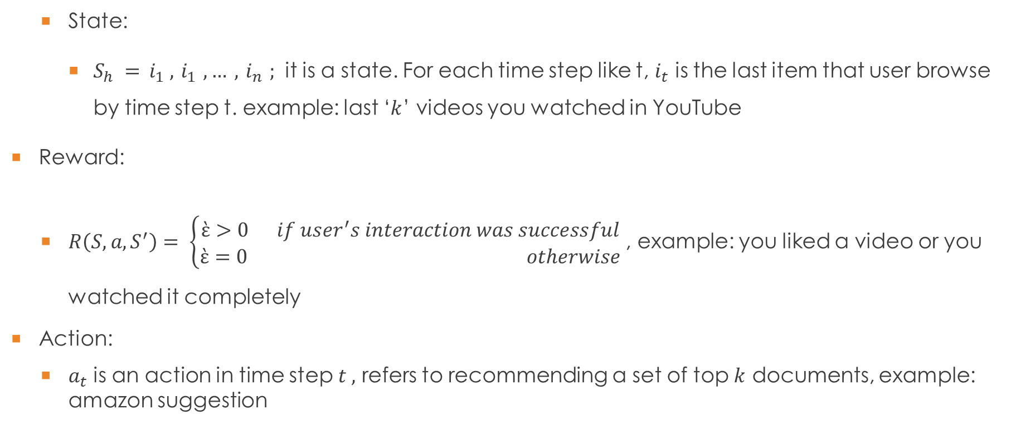
Problem Description / Formulation
State:
$S_{h} = { i}_{1} ,{ i}_{1} , … ,{ i}_{n} ;$ it is a state. For each time step like t, $i_{t}$ is the last item that user browse by time step t. example: last ‘$k$’ videos you watched in YouTube
Reward:
$R\left(S,a,S^{′}\right)= \left\{\begin{aligned}ὲ>0 if user^{′}s interaction was successful \\ ὲ=0 otherwise\end{aligned}\right.$ , example: you liked a video or you watched it completely
Action:
$a_{t}$ is an action in time step $t ,$ refers to recommending a set of top $k$ documents, example: amazon suggestion
8/12

Slide 9
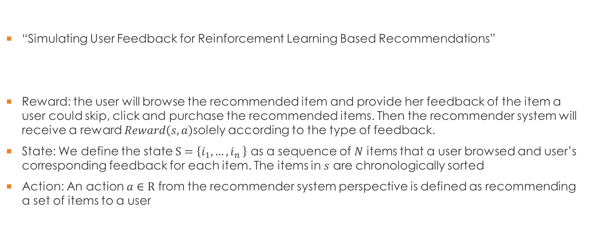
Related works
“Simulating User Feedback for Reinforcement Learning Based Recommendations”
Reward: the user will browse the recommended item and provide her feedback of the item a user could skip, click and purchase the recommended items. Then the recommender system will receive a reward $Reward\left(s,a\right)$solely according to the type of feedback.
State: We define the state $S=\left\{i_{1}{,…,i}_{n}\right\}$ as a sequence of $N$ items that a user browsed and user’s corresponding feedback for each item. The items in $s$ are chronologically sorted
Action: An action $a∈R$ from the recommender system perspective is defined as recommending a set of items to a user
9/12

Slide 10
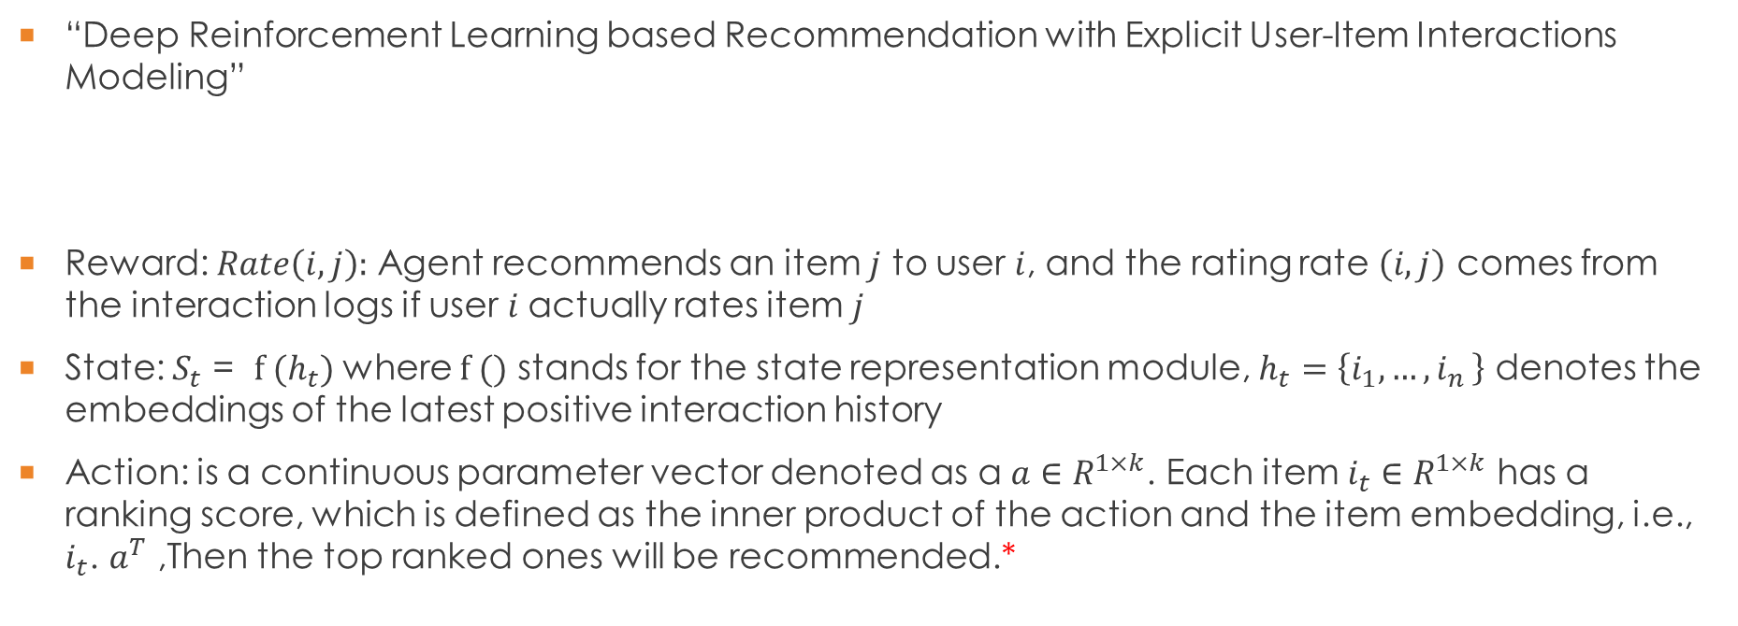
Related works: part2
“Deep Reinforcement Learning based Recommendation with Explicit User-Item Interactions Modeling”
Reward: $Rate\left(i,j\right):$ Agent recommends an item $j$ to user $i$, and the rating rate $\left(i,j\right)$ comes from the interaction logs if user $i$actually rates item $j$
State: $S_{t}$ = $f (h_{t})$ where $f ()$ stands for the state representation module, $h_{t}=\left\{i_{1}{,…,i}_{n}\right\}$ denotes the embeddings of the latest positive interaction history
Action: is a continuous parameter vector denoted as a $a∈R^{1×k}$. Each item $i_{t}∈R^{1×k}$ has a ranking score, which is defined as the inner product of the action and the item embedding, i.e., $i_{t}$. $a^{T}$ ,Then the top ranked ones will be recommended.*
10/12

Slide 11
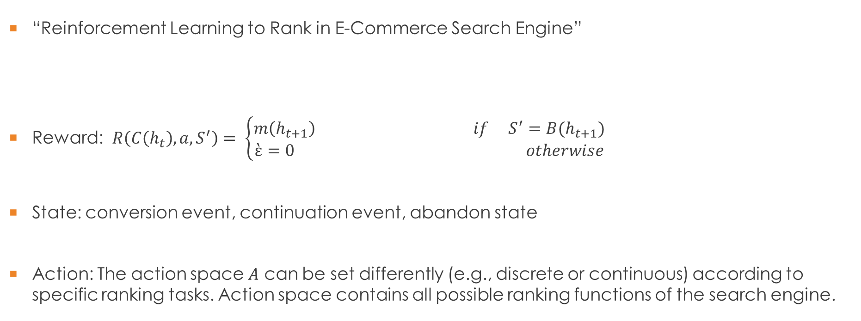
Final case
“Reinforcement Learning to Rank in E-Commerce Search Engine”
Reward: $R\left(C\left(h_{t}\right),a,S^{′}\right)= \left\{\begin{aligned}m\left(h_{t+1}\right) if{ S}^{′}=B(h_{t+1}) \\ ὲ=0 otherwise\end{aligned}\right.$
State: conversion event, continuation event, abandon state
Action: The action space $A$ can be set differently (e.g., discrete or continuous) according to specific ranking tasks. Action space contains all possible ranking functions of the search engine.
11/12

Slide 12
Hierarchy Graph for representing type of methods
Reinforced Recommender Systems
One Agent
One State (Multi Armed Bandit)
Multi State
Multi-Agent
“MarlRank”
“RL approaches to Movie Recommendation”
“RL in E-commerce search engine”, “Simulating User Feedback for RL Based Recommendation”,…
12/12

